Slide 1
Lecture-1 Periodicity of the elements

Slide 2
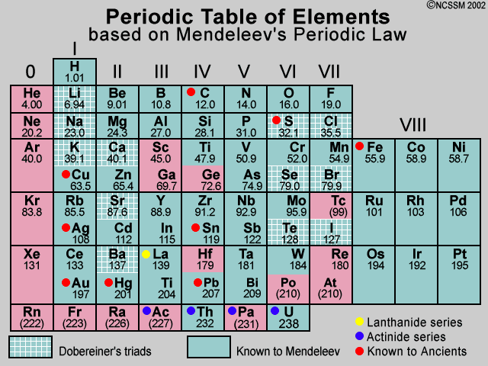
Mendeleev’S Law
The properties are a periodic function of their atomic mass

Slide 3
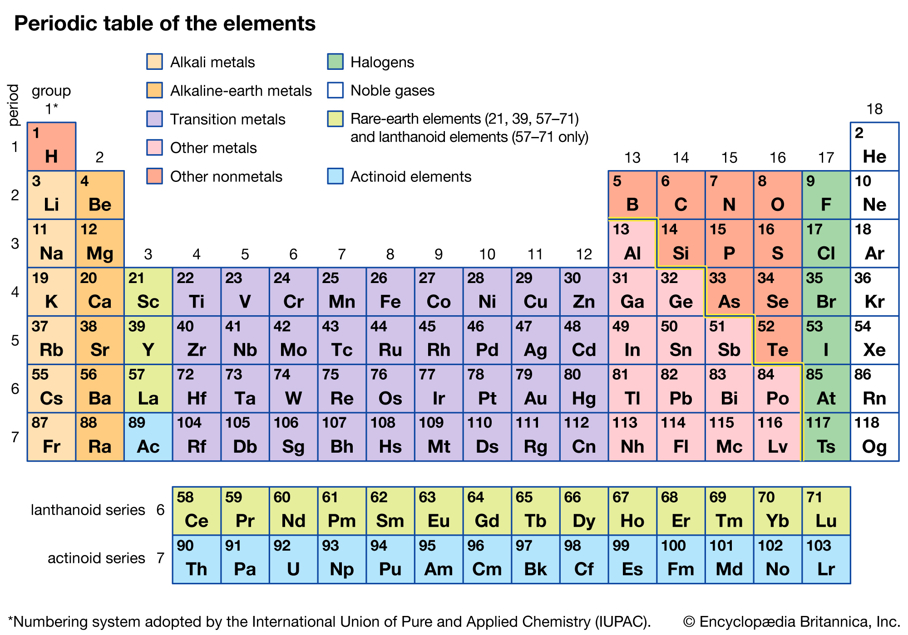
Modern Periodic Table

Slide 4
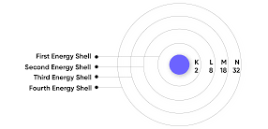
distribution of electron in atom
Electron Capacity= 2n²
^{where, n=Shell number}

Slide 5
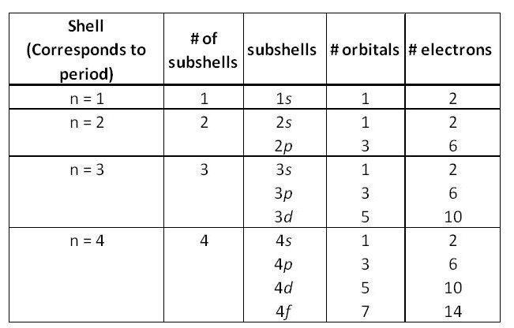
distribution of electron in atom
Sub shells(l) are the orbitals with the s, p, d and f shells that have their own unique quantum numbers and spin patterns when electrons are treated as waves.
Number of subshell in a shell= shell number; n=2 has two sub shells- s, p.
First subshell s has 1 orbital and each successive subshell adds 2 more orbitals. So p has 3, d has 5 and f has 7 orbitals.
Each orbital can hold only 2 electrons of opposite spin.

Slide 6
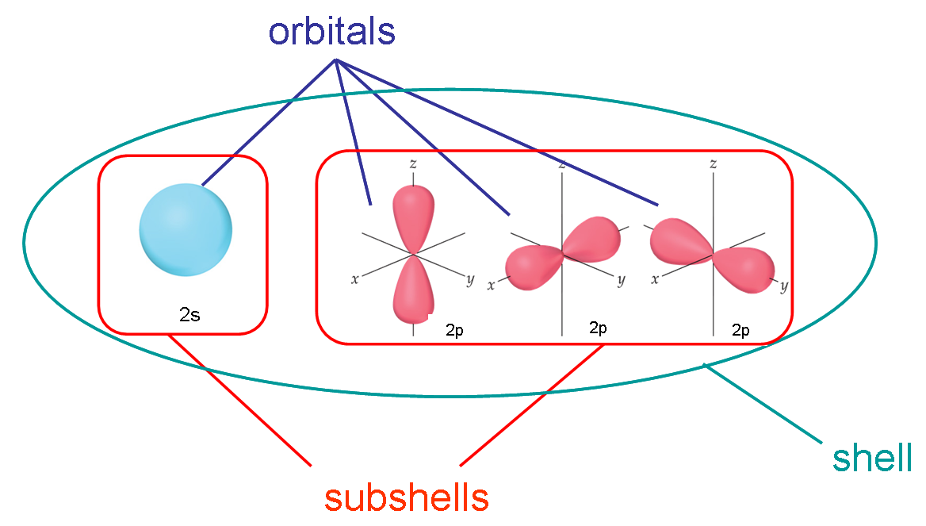
distribution of electron in atom

Slide 7
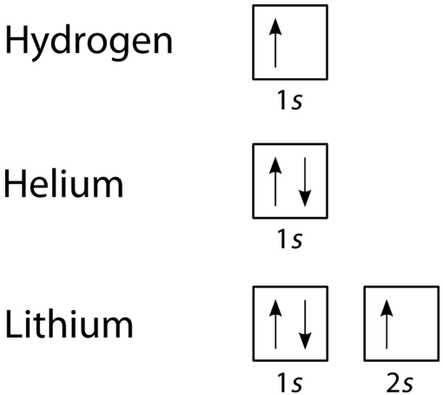
Pauli exclusion principle
In an atom or molecule, no two electrons can have the same four electronic quantum numbers. As an orbital can contain a maximum of only two electrons, the two electrons must have opposing spins. This means if one electron is assigned as a spin up (+1/2) electron, the other electron must be spin-down (-1/2) electron.

Slide 8
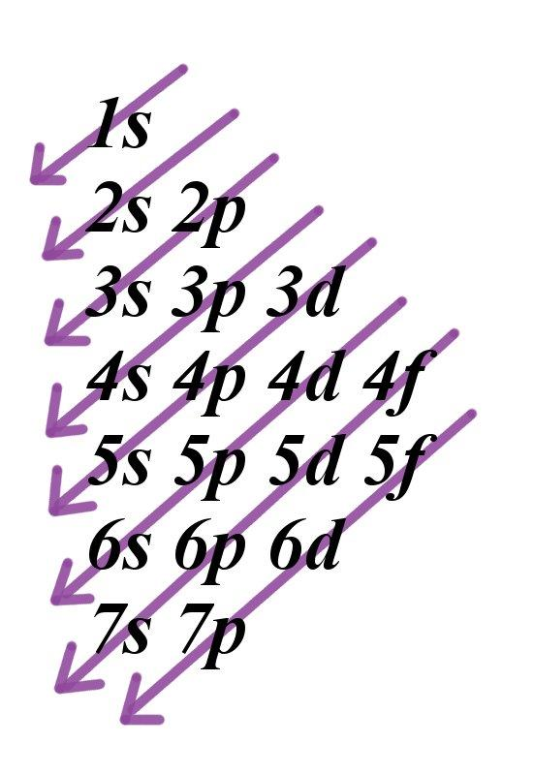
The Aufbau principle
The Aufbau principle dictates the manner in which electrons are filled in the atomic orbitals of an atom in its ground state.
It states that electrons are filled into atomic orbitals in the increasing order of orbital energy level. According to the Aufbau principle, the available atomic orbitals with the lowest energy levels are occupied before those with higher energy levels. So, an electron occupies orbitals in order from lowest energy to highest.
The Aufbau (German for building up, construction) principle is sometimes referred to as the "building up" principle.
Construction of a building begins at the bottom. The foundation is laid, and the building goes up step by step.
The lowest energy sublevel is always 1s and then step by step energy goes up 2s, 2p, 3s and so on.

Slide 9
The Aufbau principle
Example of Aufbau Principle:
Sulphur has an atomic number of 16, indicating that it has a total of 16 electrons.
According to the Aufbau principle, two of these electrons are in the 1s subshell, eight are in the 2s and 2p subshells, and the rest are dispersed between the 3s and 3p subshells.
As a result, sulphur’s electron configuration can be expressed as 1s² 2s² 2p⁶ 3s² 3p⁴

Slide 10
Heisenberg uncertainly principle
Heisenberg’s uncertainty principle states that it is impossible to measure or calculate exactly, both the position and the momentum of an object. This principle is based on the wave-particle duality of matter.
It is impossible to measure or calculate exactly, both the position and the momentum of an object.
More specifically, if one knows the precise momentum of the particle, it is impossible to know the precise position and vice versa.

Slide 11
Mathematically this situation is represented by:
ΔpΔx ≥ h/4π
Where, Δx = position of the particle
Δp= momentum of the particle
H= Plank”s constant

Slide 12
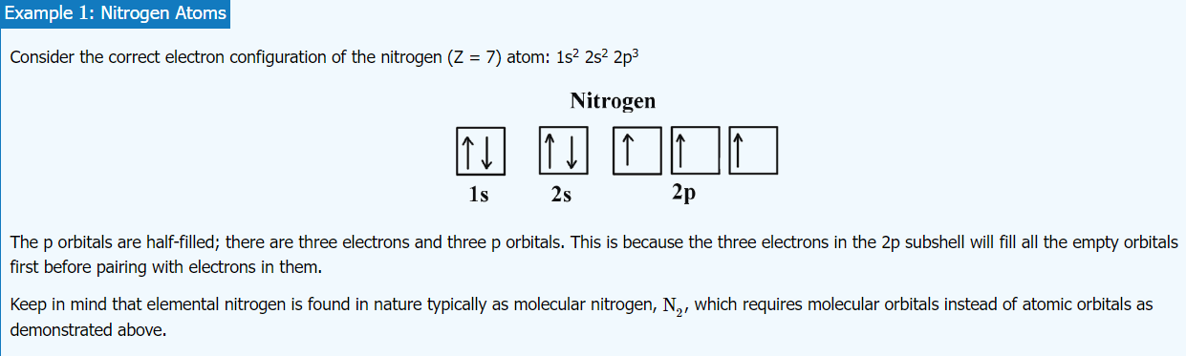
The Hund's rule
“Every orbital in a sublevel is singly occupied before any orbital is doubly occupied.”
“ All of the electrons in singly occupied orbitals have the same spin (to maximize total spin).”

Slide 13
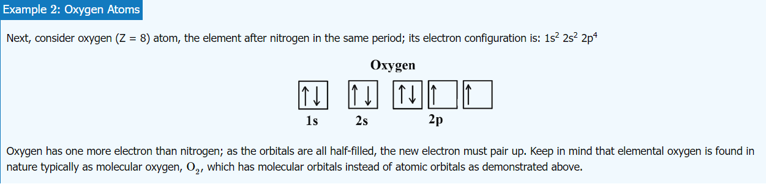
Hund's rule

Slide 14
periodic properties
1. Atomic Radius
The atomic radius is the distance from the atomic nucleus to the outermost stable electron of a neutral atom.
In practice, the value is obtained by measuring the diameter of an atom and dividing it in half.
The radii of neutral atoms range from 30 to 300 pm or trillionths of a meter.
2. Ionic Radius
The ionic radius is half the distance between two gas atoms that are just touching each other.
Values range from 30 pm to over 200 pm.
In a neutral atom, the atomic and ionic radii are the same.
If the atom loses its outermost electron (positively charged or cation), the ionic radius is smaller than the atomic radius.

Slide 15
periodic properties
3. Ionization potential
the amount of energy required to remove an electron from an isolated atom or molecule
Ionization potential increases going left to right across a period because of increased nuclear attraction.
Going down the group the Ionization potential should decrease since the electron is being added increasingly further away from the nucleus. Electron becomes less tightly bound and can be easily removed.
4. Electron affinity
The amount of energy released when an electron is added to a neutral atom to form an anion.
Electron affinity increases going left to right across a period because of increased nuclear attraction.
Going down the group the electron affinity should decrease since the electron is being added increasingly further away from the nucleus. Electron becomes less tightly bound and can be easily removed.

Slide 16
Thank You

